Slide 1
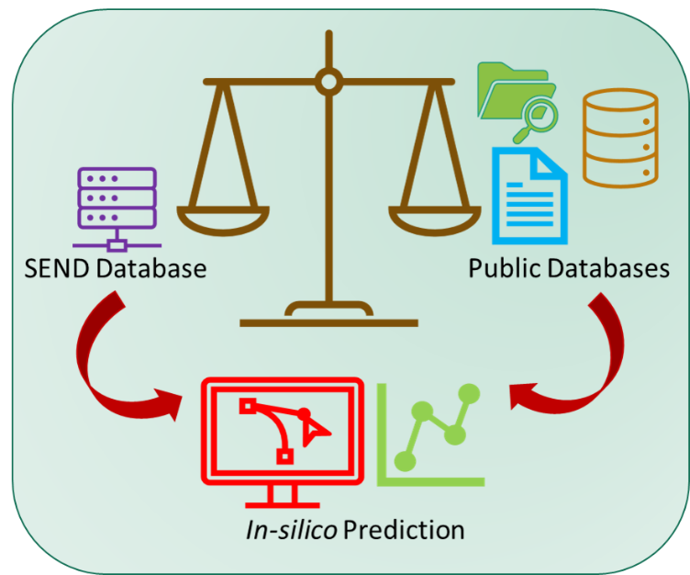
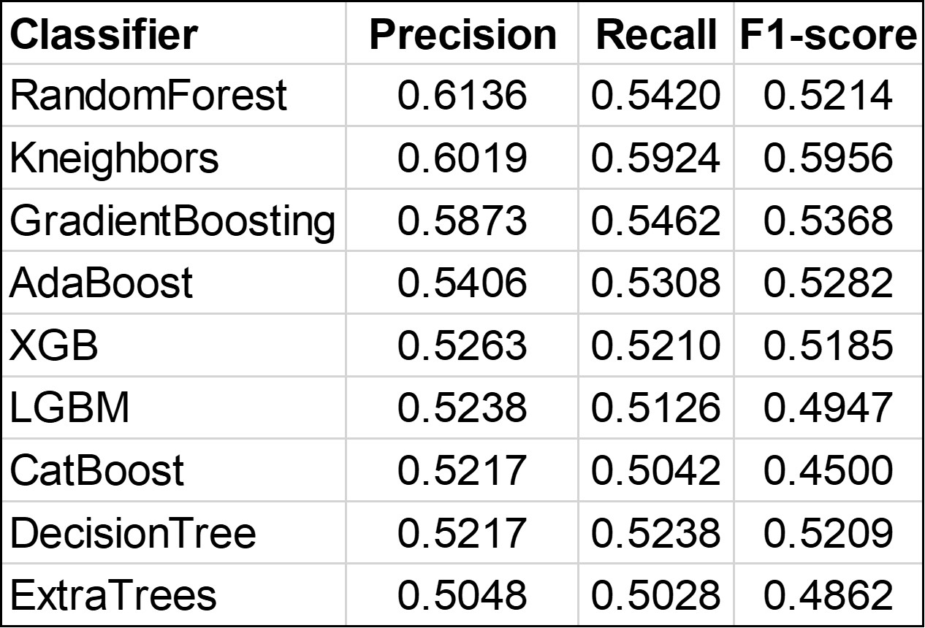
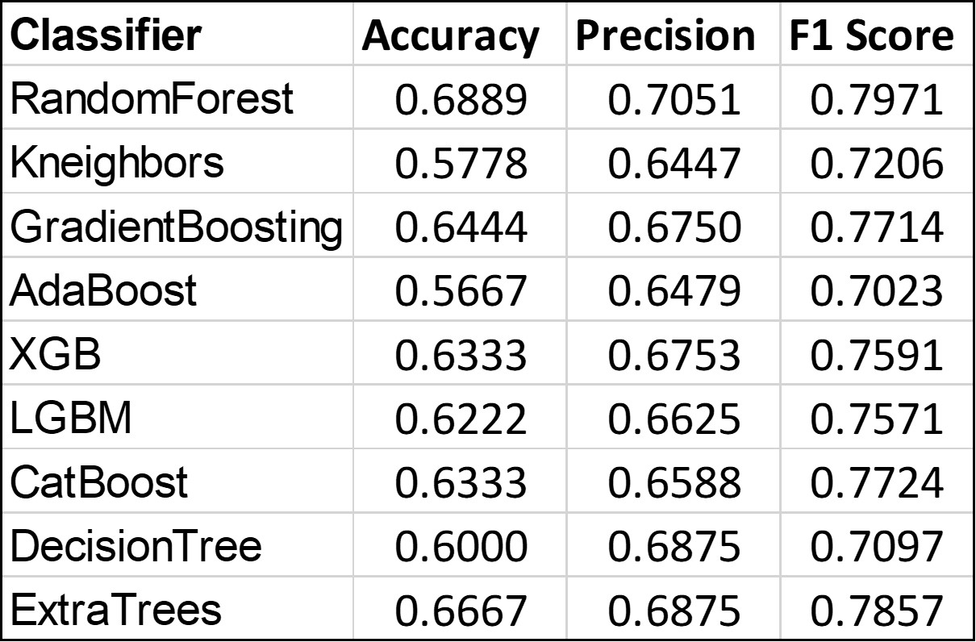
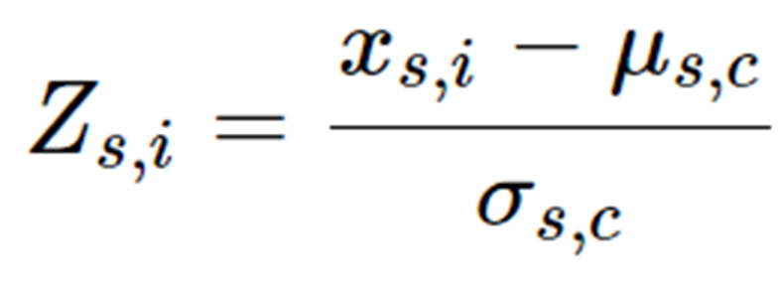
In Silico Toxicity Assessment by QSAR Model: Bridging the Knowledge Gap Using Standardized Electronic Submission Data
Md Aminul Islam Prodhan^{1,2}, C M Sabbir Ahmed¹, Kevin Snyder¹
¹U.S. Food and Drug Administration (FDA), Silver Spring, MD; ²Oak Ridge Institute for Science and Education, Oak Ridge, TN.
BACKGROUND
RESULTS
Quantitative structure activity relationship (QSAR) modeling is currently used in CDER to qualify the safety of drug substance impurities with respect to genetic toxicology; however, reliable use of QSAR with respect to general toxicology endpoints has yet to be robustly demonstrated. CDER has recently started to receive electronic SEND datasets along with study reports from in vivo general toxicology studies, and automated analyses of these SEND datasets can be used to build QSAR models to predict the toxicological profile of novel compounds with structures similar to those present in the database.
Body weight was selected as the first general toxicology study endpoint to be addressed primarily because it is a relatively simple endpoint to normalize and analyze in the context of QSAR modeling. Although the mechanistic causes of drug-induced decreases in body weight may be diverse, it is possible that the model may be able to reliably predict the absence of this effect for certain classes of chemical structures. Modeling of complex, multi-endpoint toxicities, e.g. hepatotoxicity, will be conducted in the future.
Table 1. ML performance metrics
Table 2. performance metrics on prediction
The data analysis provided 1988 unique rows of 447 unique compounds. The rows were unique based on the compounds, species and sex value. From this 1988 rows, 447 unique rows were selected based on unique SMILES notation. Among 447 rows, 357 rows were used for model building and 90 rows used for toxicity prediction. From the training data set, the resulting classifiers showed moderate overall accuracy (balanced accuracy, average 55%) with other metrics as described in Table 1. The testing data set ( Table 2) showed an overall average accuracy of around 62% on toxicity prediction. To improve the model, we also applied the features reduction method and highly correlated features were removed and then model were built and tested . However, there were no significant improvement in terms of toxicity prediction.
Figure 1. Schematic of QSAR modeling
QSAR MODEL BUILDING
METHODS
Animal body weight z-score data and the corresponding calculated molecular descriptors were used to build the machine learning classifier and predict the probability of toxicity. Z-score values were binned into different classes and used as the response variable for the molecular descriptors. Body weight z-score data were respectively binned into two categories: toxic, and non-toxic based on the following threshold values z-score ≤ -2 , and z-score > -2.
The data were split into training data (80%) and test data (20%) . The models were validated by k-fold-cross validation. In addition, We also applied a feature selection technique to remove the highly correlated features. The hyper-parameters of the models were optimized by the grid search method. In addition to chemical descriptor, species and SEX of the animal were also used as a features by converting them in numerical values by encoding technique.
BODY WEIGHT Z-SCORE CALCULATION
DISCUSSION AND FUTURE DIRECTIONS
The weight of each animal at the end of the dosing period in each study was initially normalized by subtracting their baseline weights on the first day of dosing. These values then were normalized via Z-score (Equation 1) to the respective control groups for each study.
It was not altogether surprising that model performance was not sufficient to produce reliable predictions of drug-induced decreased in body weight as this endpoint could be driven by a wide variety of pharmacological mechanisms; however, the infrastructure that was developed to build models to predict this endpoint can be easily repurposed to predict other types of toxicity, e.g. hepatotoxicity, cardiotoxicity, nephrotoxicity. Although the integration of study endpoints related to these types of toxicity into a single response variable score that can be modeled and predicted will be challenging, it is likely that the relationship between chemical features and these more distinct, mechanistically-driven toxicities will be able to be modeled with greater reliably.
In the future, incorporation of structural alert data from the chemical structure of the compounds may also be implemented to improve the model. Additionally, the model may be able to be enhanced by incorporation of data from publicly available sources, e.g. ToxRefDB.
Equation 1. Z-score equation for data normalization where x is the endpoint value being observed, µ is the mean value of that endpoint, σ is the standard deviation of that endpoint, s is the study, i is an individual animal from that study, and c is the control-treated group of animals from that study.
MOLECULAR DESCRIPTOR CALCULATION
Python version 3.9.12, scikit-learn, SQLite3 and R version 4.3.1 was used for data analysis and implementing various machine learning algorithms. Mordred, a python-based descriptor calculator package, was used for molecular descriptor calculation. Mordred is a python-based software that can calculate more than 1800 two- and three-dimensional descriptors. SMILES molecular notation was used for descriptor calculation. As SEND datasets do not natively contain SMILES strings, SMILES strings were retrieved from the GSRS dataset in combination with the SEND dataset based on application number. After removing highly correlated descriptors, 194 final descriptors were used for the machine leaning classifier model building.
MODEL PERFORMANCE EVALUATION
ACKNOWLEDGEMENT
Four metrics (precision, recall, f1-score, and accuracy) were used to assess model performance as described by the traditional equations containing the true positive, false positive, true negative, and false negative cases.
This project was supported in part by an appointment to the Research Fellowship Program at the Immediate Office/OND/CDER, U.S. Food and Drug Administration, administered by the Oak Ridge Institute for Science and Education through an interagency agreement between the U.S. Department of Energy and FDA..

